Slide 1
Mall Customers Segmentation
Isula Dissanayake
KIC–HNDCSAI–252F–003
Dataset No: 03
GitHub: https://github.com/heyisula/customerseg_ml

Slide 2
Problem Statement
Challenge:
Goal:
How to increase supermarket membership card conversion rates?
Identify customer groups with similar shopping behaviors to enable targeted marketing
Expected Benifit:
Approach:
Personalized strategies for each customer segment
Customer segmentation using clustering techniques

Slide 3
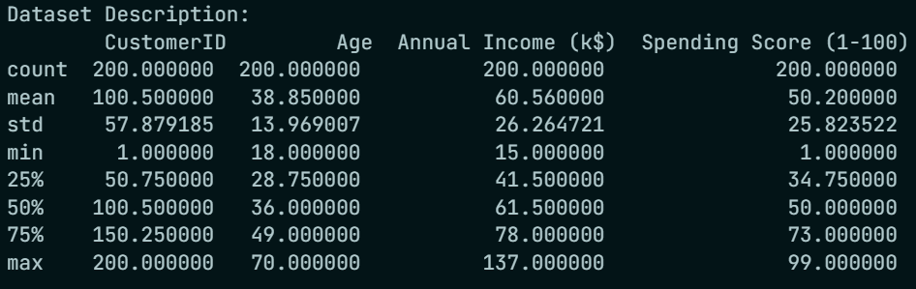
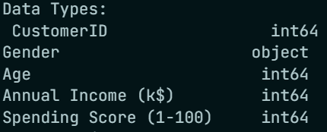
Dataset Overveiw
Dataset Size:
Dataset Size:
Rows: 200
Columns: 5
Missing Values: None
Duplicate Rows: None
Key Features:
CustomerID
Gender
Age
Annual Income (k$)
Spending Score (1-100)

Slide 4
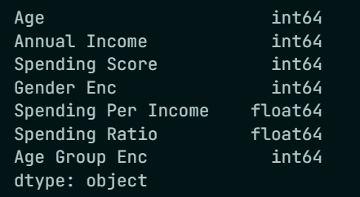
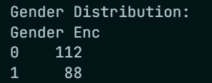
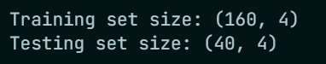
Data Preprocessing
Label Encoding: Gender converted to numeric (Female=0, Male=1)
Feature Engineering:
Spending Per Income ratio
Age Group categorization (Young/Middle/Senior/Elderly)
Spending Ratio
Standardization: Features scaled using StandardScaler
Train-Test Split: 80-20 split for validation
Renamed Features for Better Identification

Slide 5
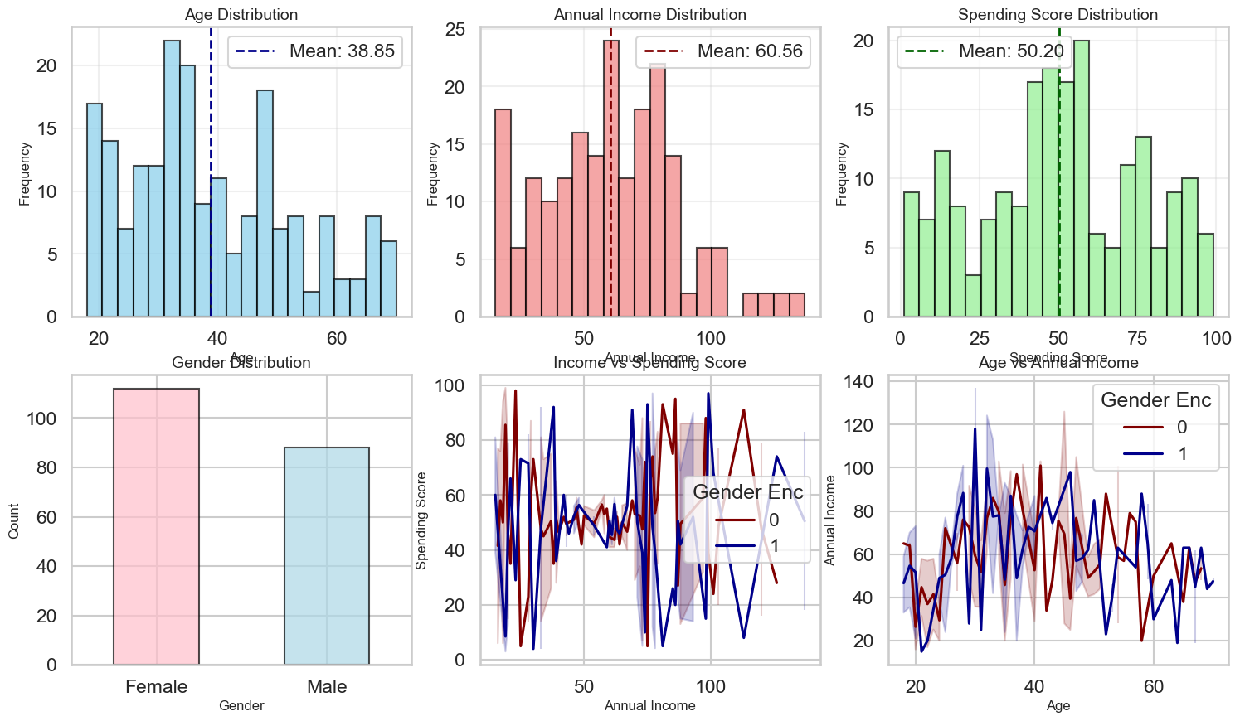
Exploratary Data Analysis - 01
Age: Mean ~39 years, ranges 18-70
Annual Income: Mean ~60k, ranges 15k-137k
Spending Score: Mean ~50, ranges 1-99

Slide 6
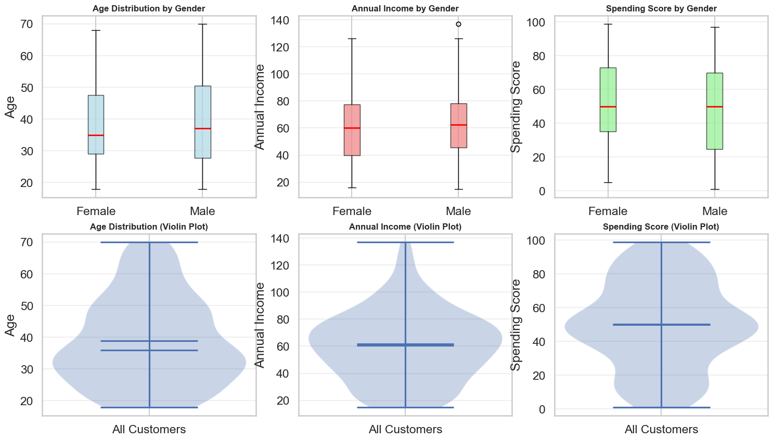
Exploratary Data Analysis - 02
Box plots reveal minimal gender differences in:
Age distribution
Annual Income
Spending behavior
Violin plots show data density patterns

Slide 7
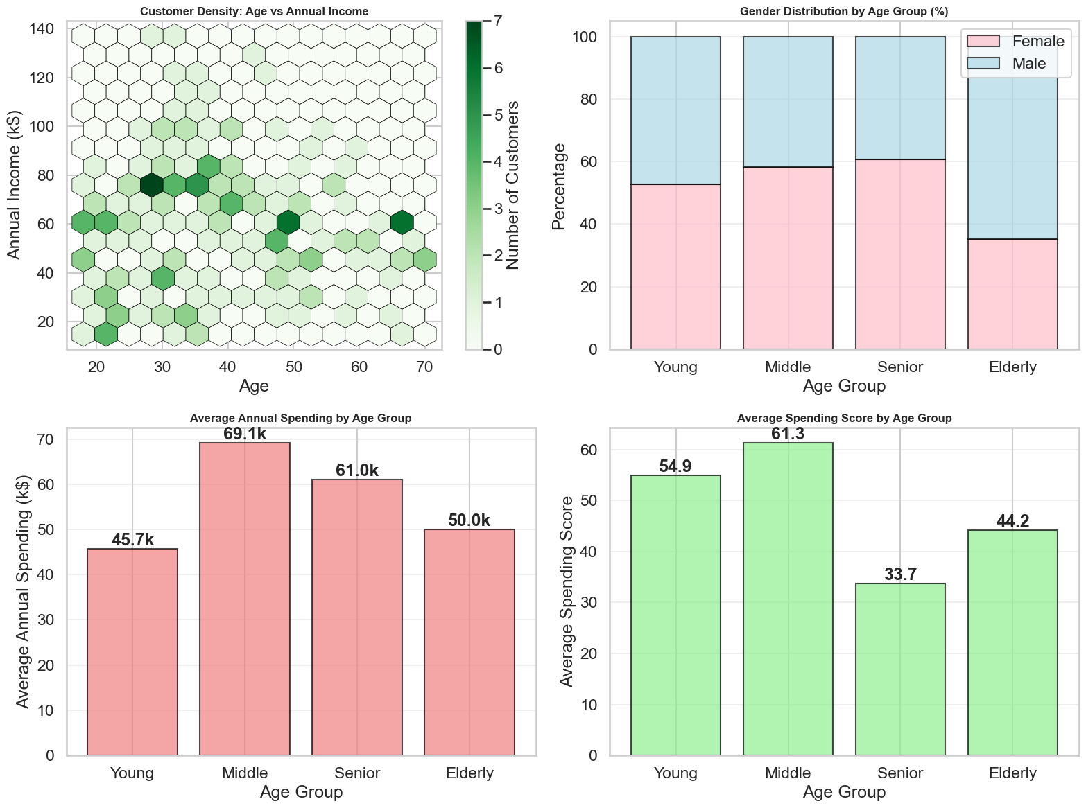
Exploratary Data Analysis - 03
Customer Density: Concentration of customers by age and income
Age Group Analysis:
Middle-aged customers dominate
Balanced gender distribution across age groups
Spending patterns vary by age group

Slide 8
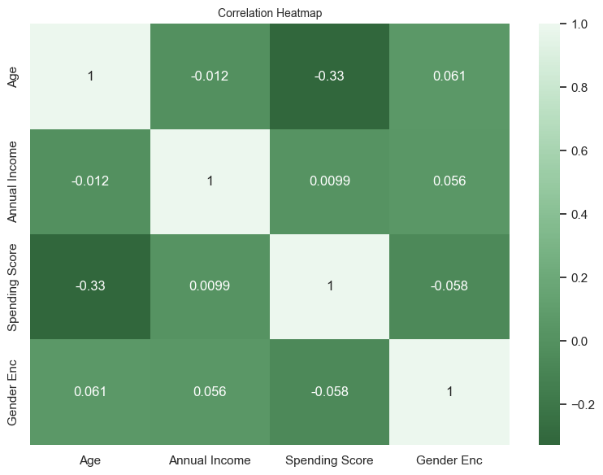
Correlation Analysis
Insights:
Weak correlation between Annual Income and Spending Score
Age shows minimal correlation with other features
Gender has negligible impact on spending patterns
Implication: Multiple features needed for effective segmentation

Slide 9
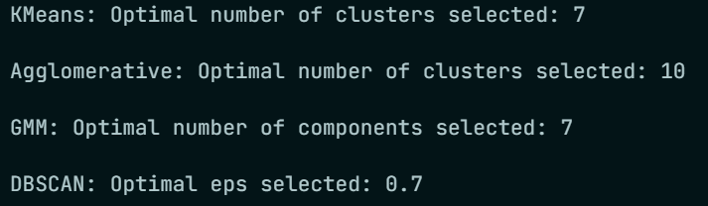
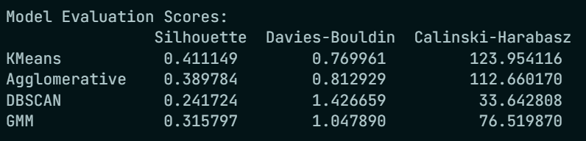
Training Models
Models Used:
K-Means: Tested k=2-10, different initialization methods
GMM: Tested components=2-10, covariance types
Agglomerative: Tested k=2-10, linkage methods
DBSCAN: Tested eps and min_samples values
Metric Used: Silhouette Score (Higher – the better Separation)

Slide 10
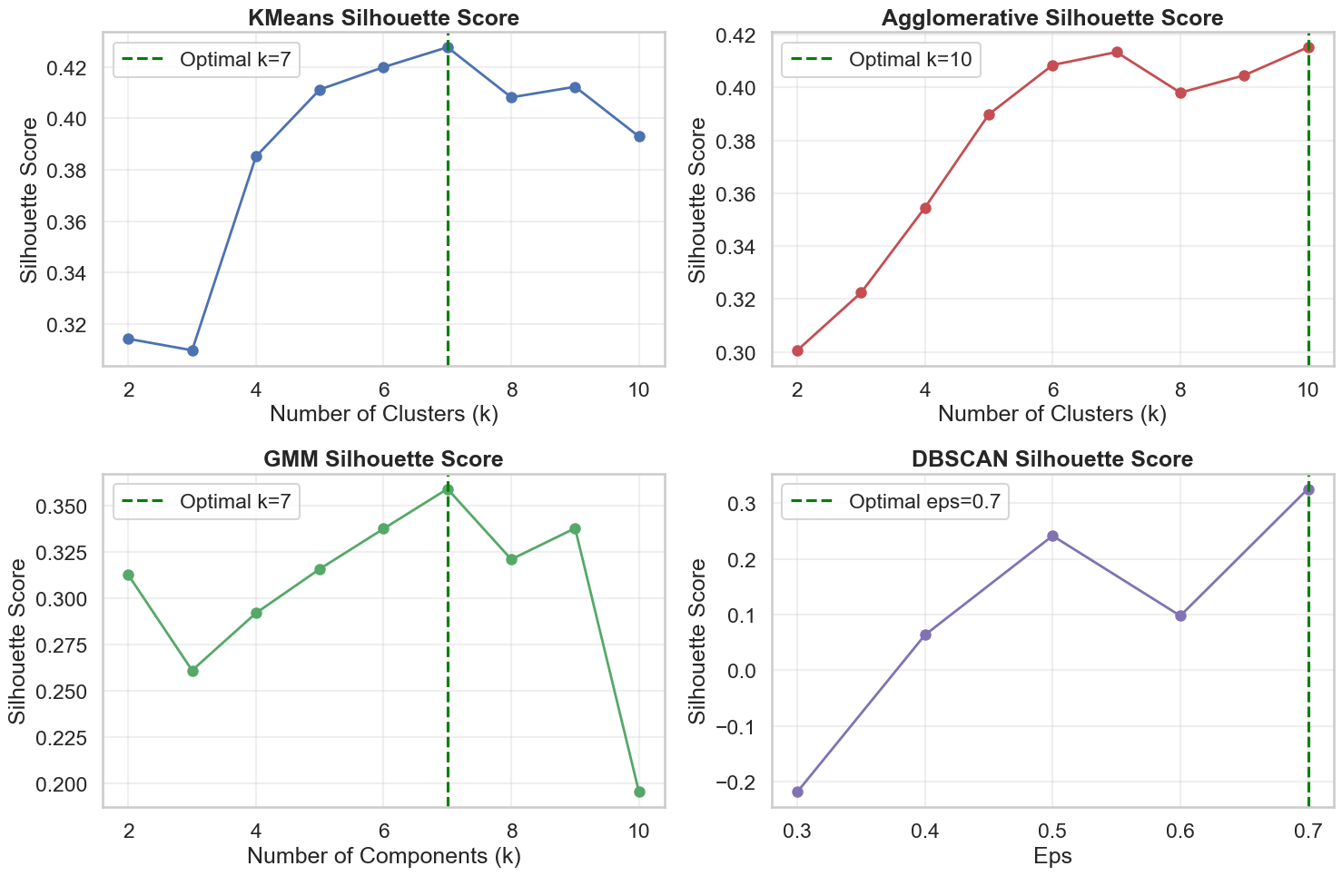
Training Models

Slide 11
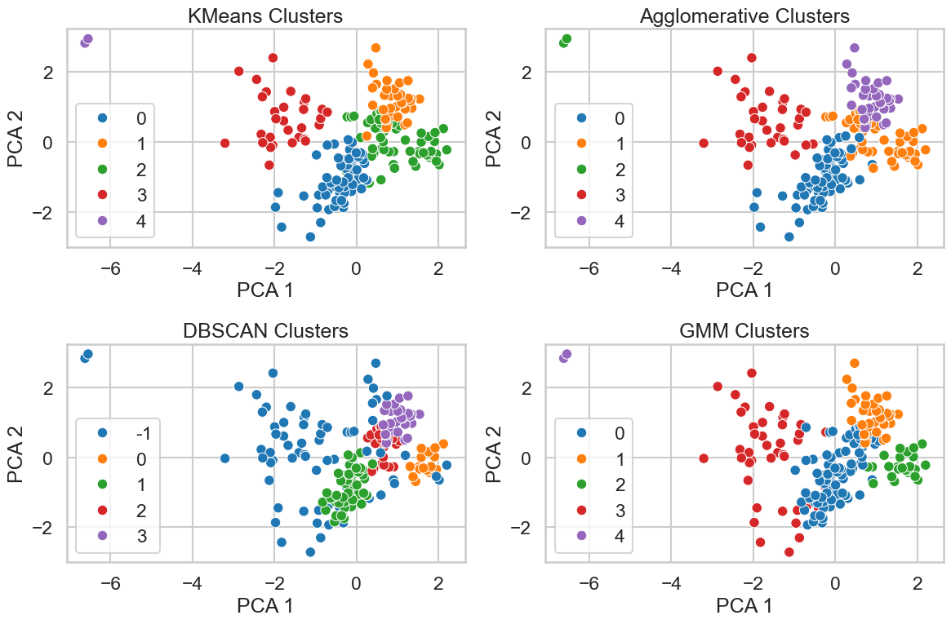
Training Models

Slide 12
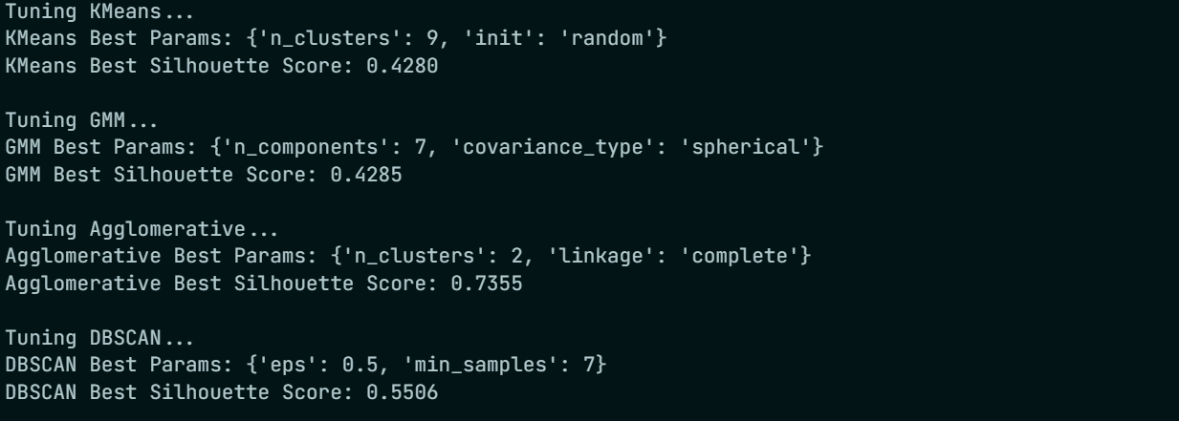
Hyperparameter Tuning
Model | Optimal Parameters | Best Silhouette Score
K-Means | k=9, init='k-means++' | 0.4280
GMM | components=7, covariance='full' | 0.4285
Agglomerative | k=2, linkage='ward' | 0.7355
DBSCAN | eps=0.5, min_samples=5 | 0.5506

Slide 13
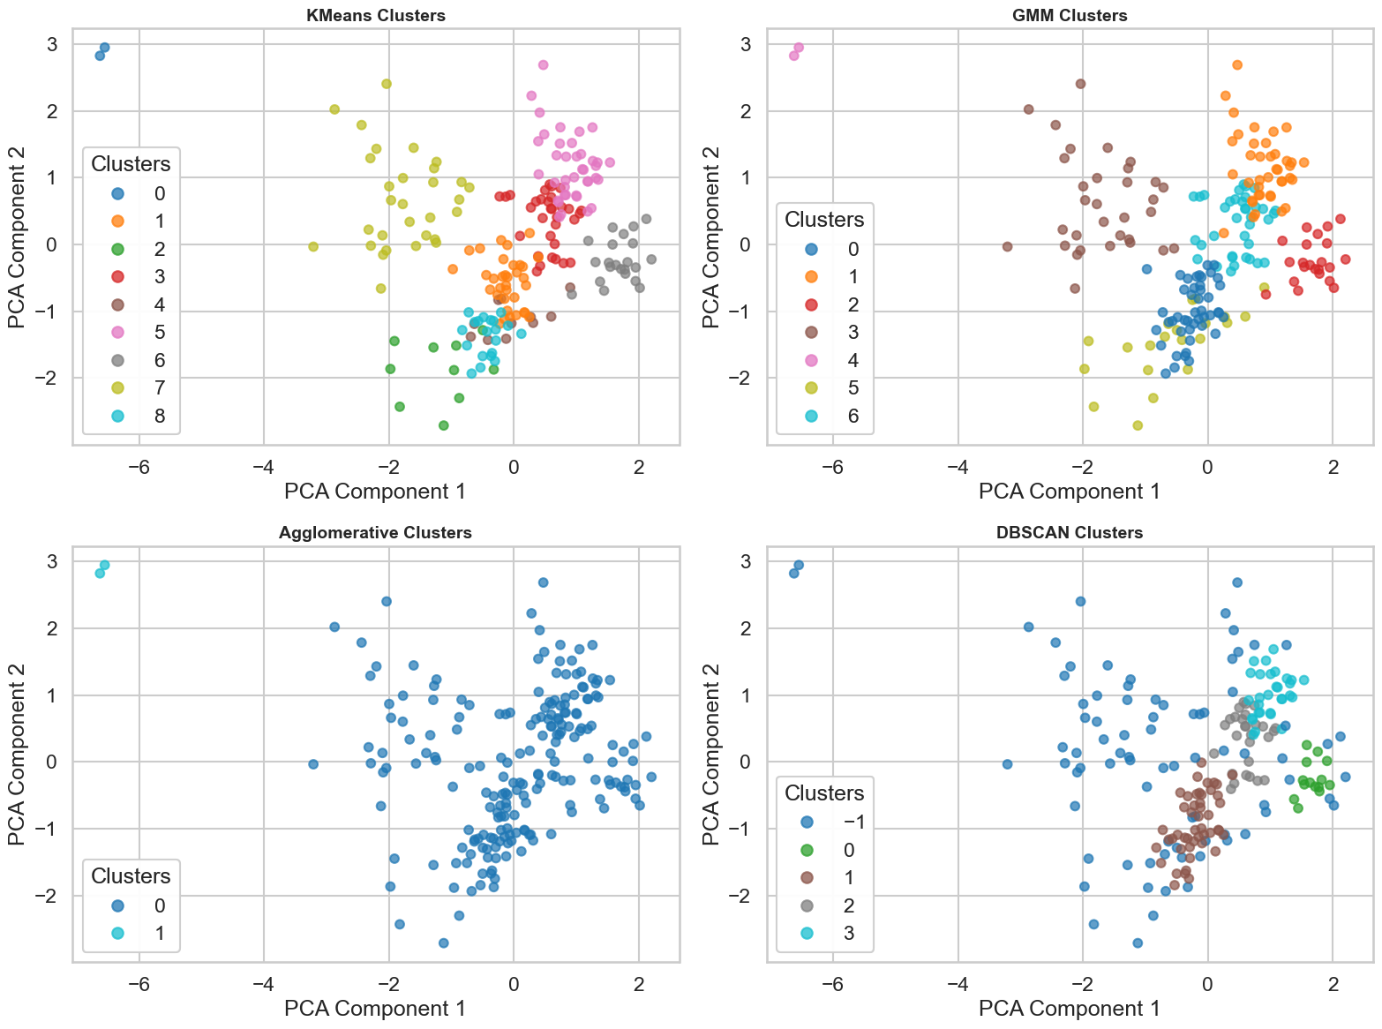
Hyperparameter Tuning

Slide 14
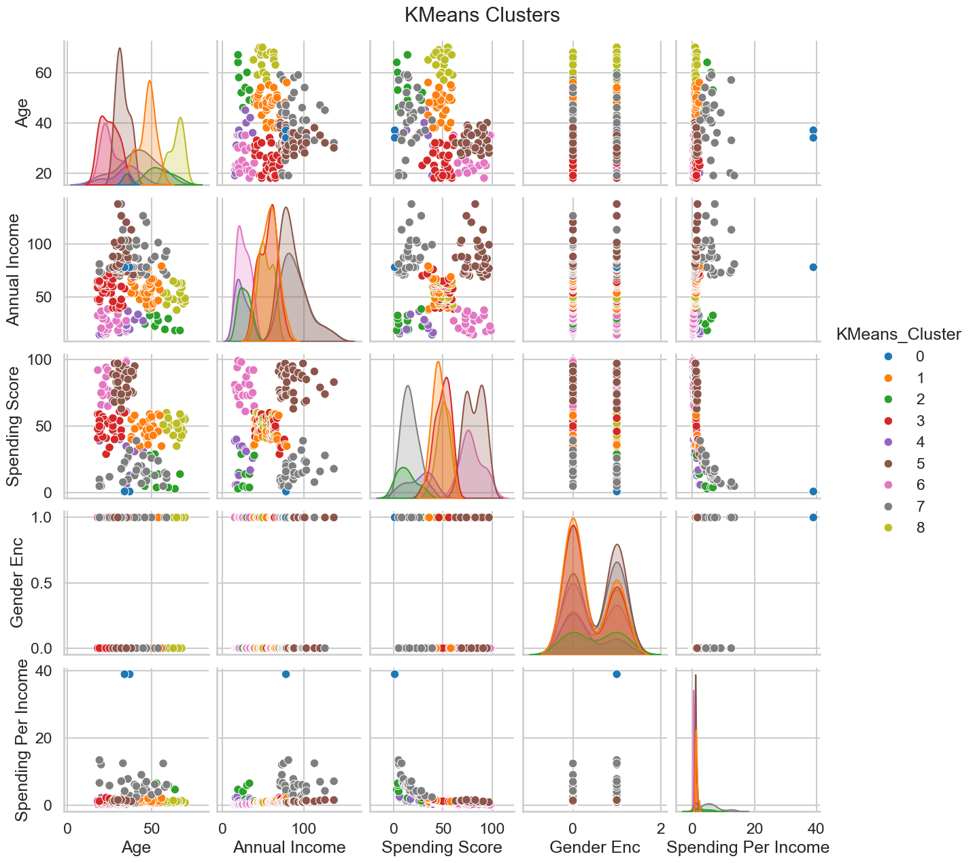
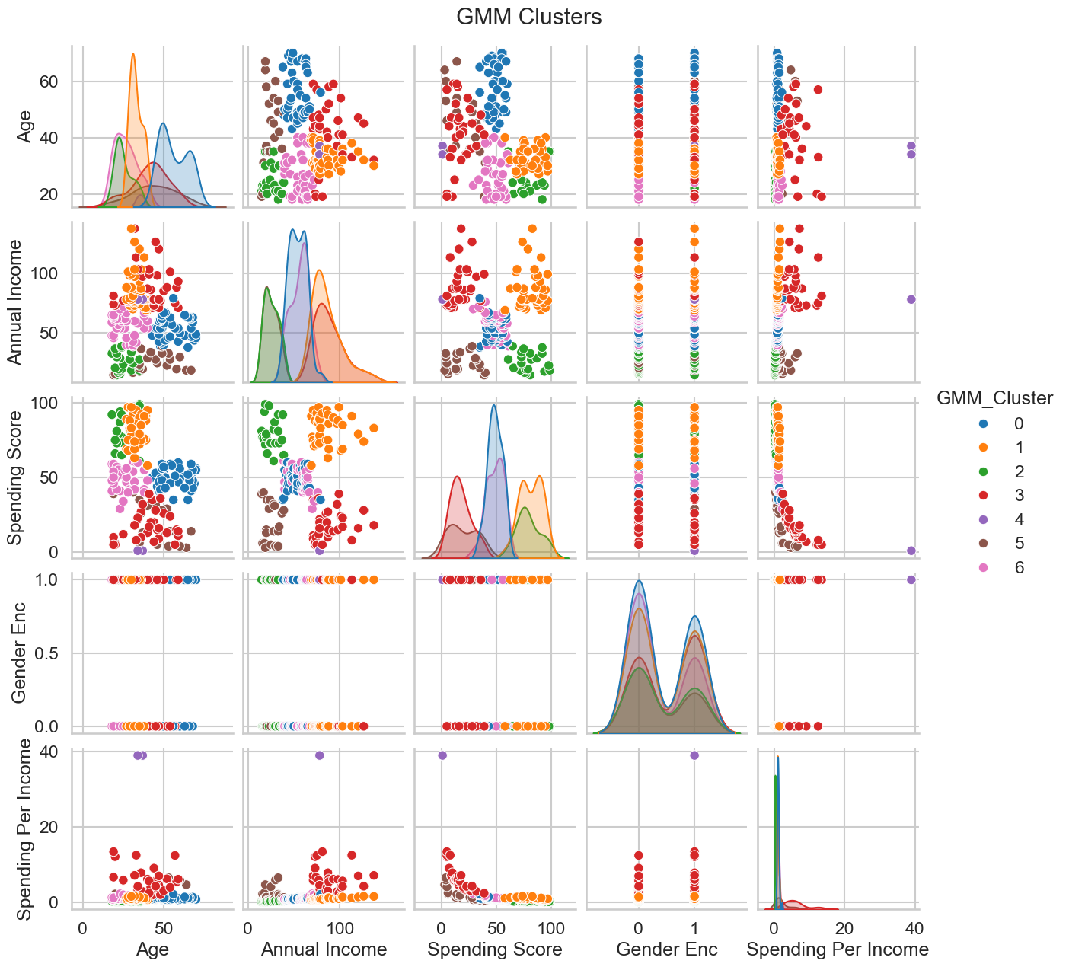
Model Evaluation

Slide 15
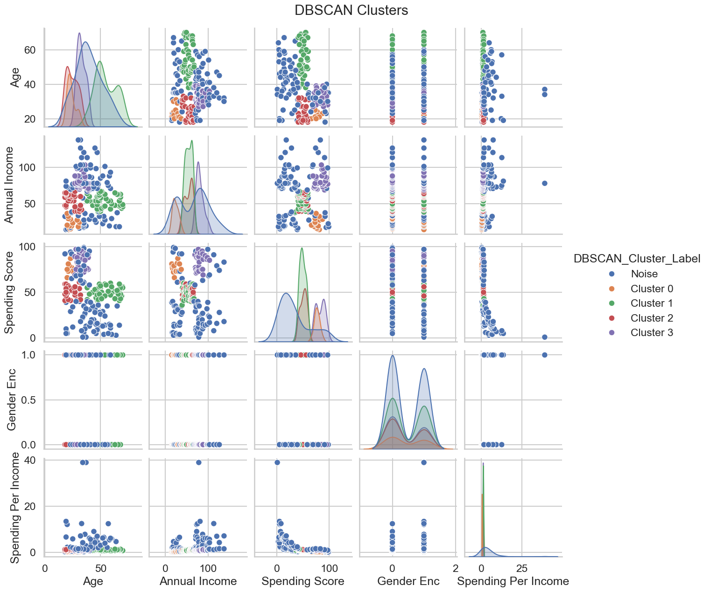
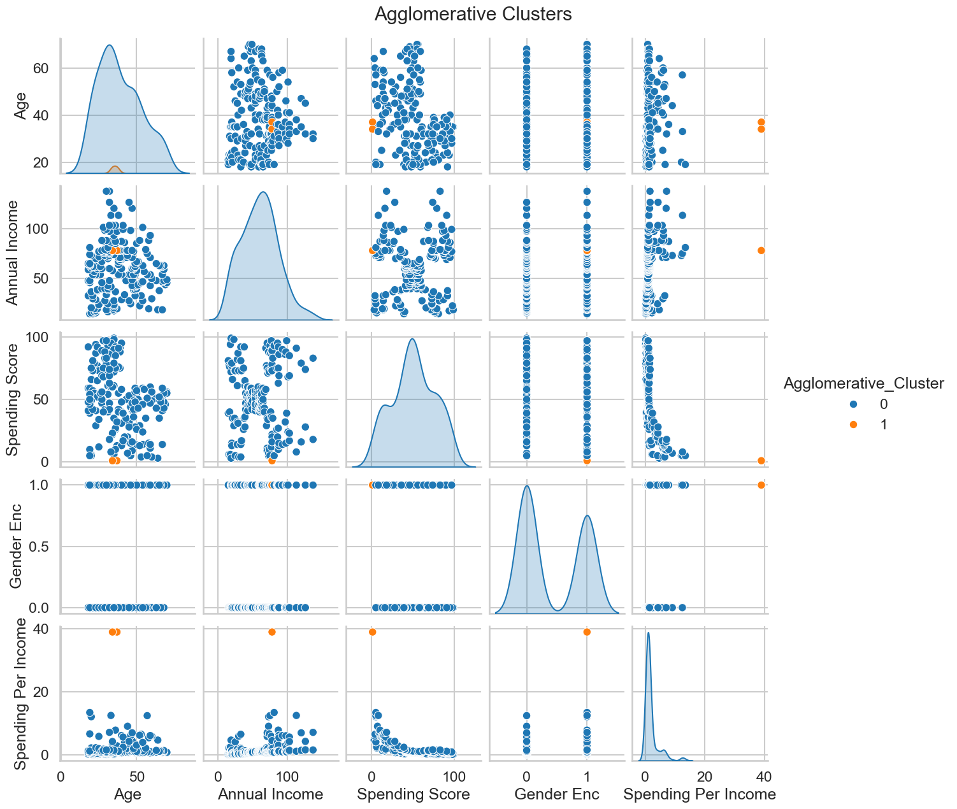
Model Evaluation

Slide 16
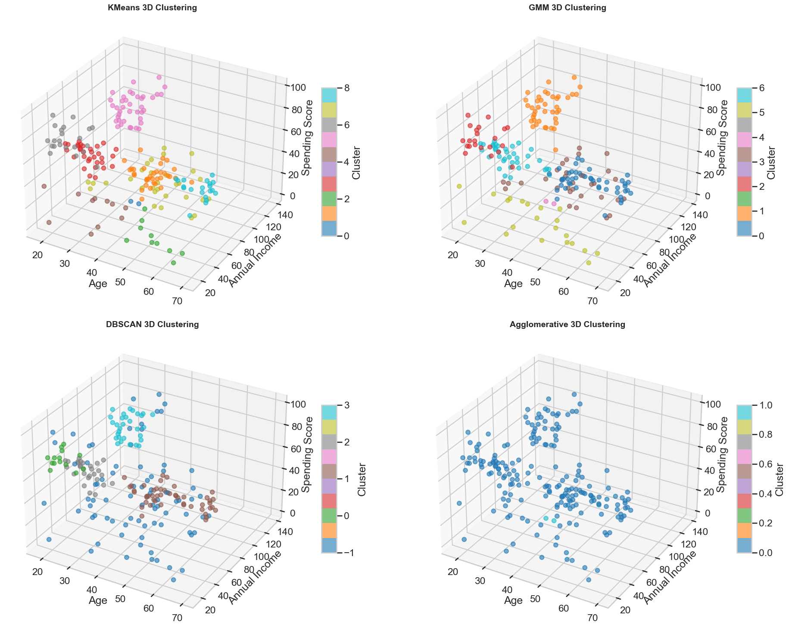
Model Evaluation

Slide 17
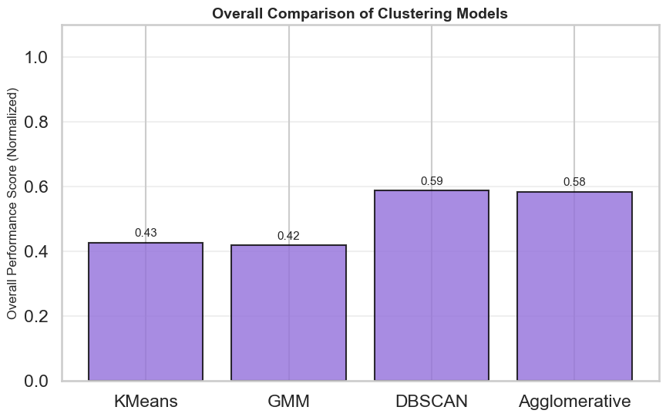
Overall Model Comparison

Slide 18
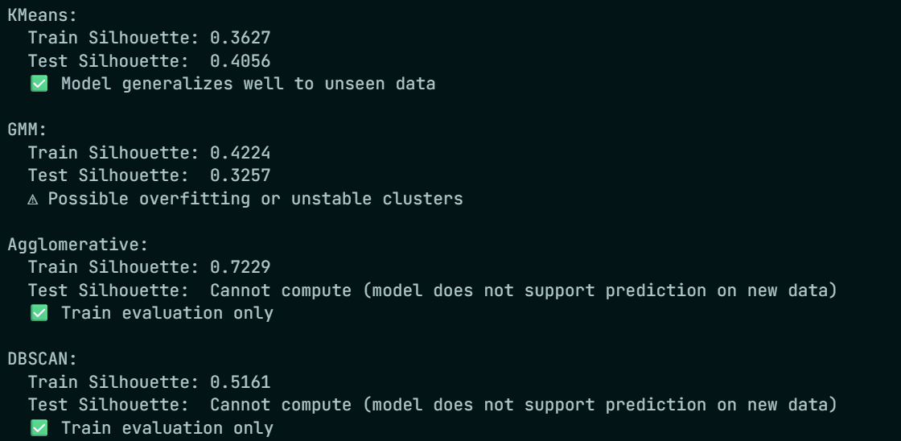
Training and Testing Performance
Model | Train Silhouette | Test Silhouette | Generalization
K-Means | 0.3627 | 0.4056 | Good
GMM | 0.4224 | 0.3257 | Overfitting
Agglomerative | 0.7229 | N/A | No prediction
DBSCAN | 0.5161 | N/A | No prediction

Slide 19
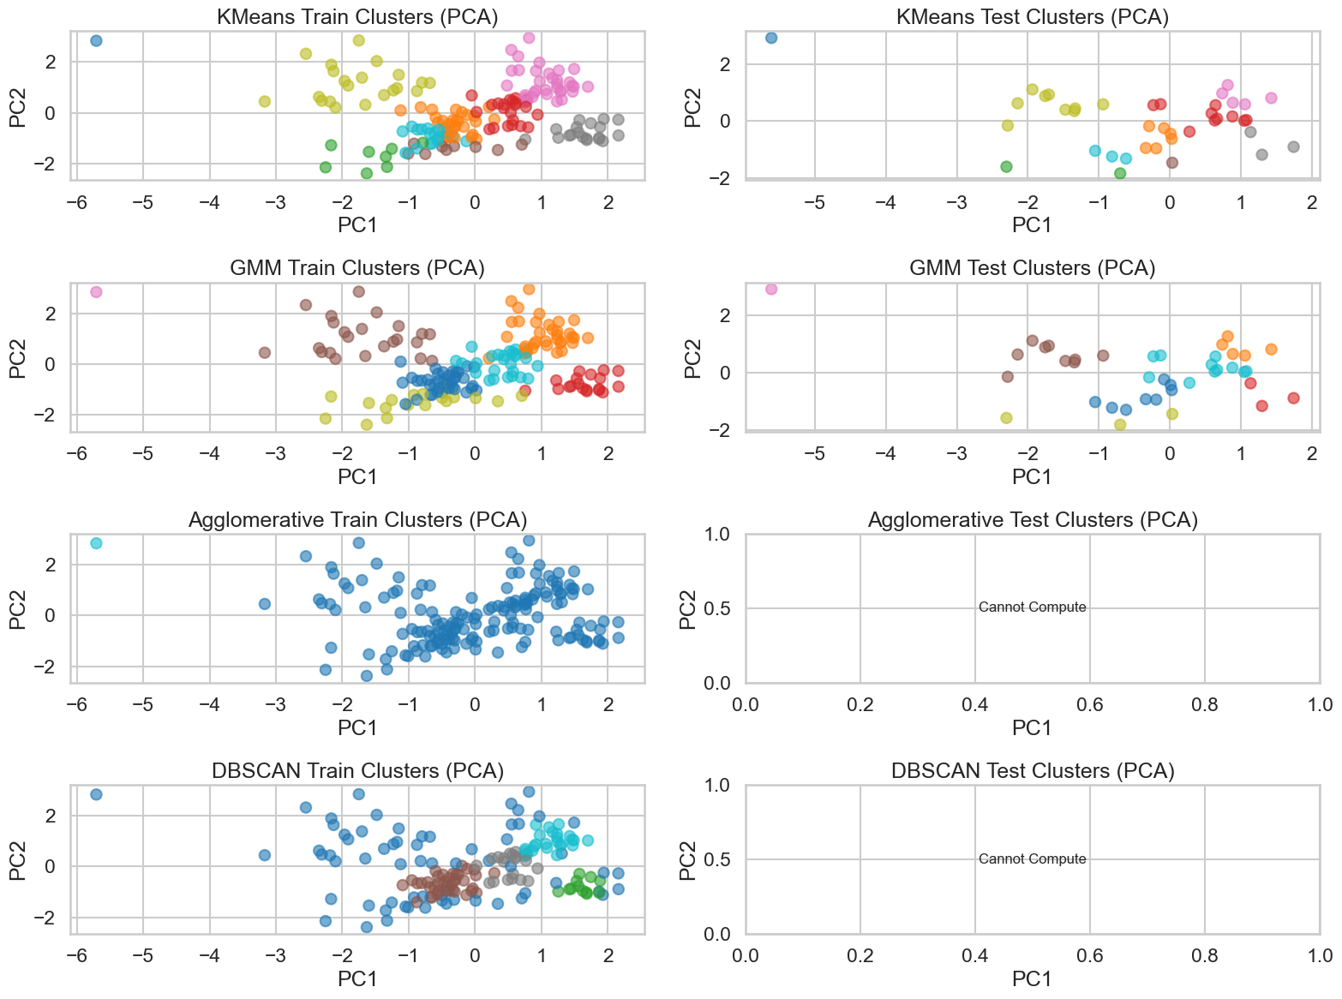
Training and Testing Performance

Slide 20
Selecting Model
Kmeans Clustering
Train Silhouette: 0.3627
Test Silhouette: 0.4056
Best Silhouette after tuning: 0.4280
Optimal clusters: 7 → 9 (after tuning) Observations:
Train and test scores are close → generalizes well.
Moderate Silhouette score indicates reasonable separation.
Easy to interpret clusters.
GMM Clustering
Train Silhouette: 0.4224
Test Silhouette: 0.3257
Best Silhouette after tuning: 0.4285
Optimal components: 7 Observations:
Train score > test score → possible overfitting.
Slightly higher best score than KMeans, but test score is lower.
Probabilistic clusters → can be useful if clusters overlap, but less stable here.
Agglomerative Clustering
Train Silhouette: 0.7229
Best Silhouette after tuning: 0.7355
Optimal clusters: 10 → 2 (after tuning) Observations:
Extremely high silhouette → might indicate overfitting to training data.
Cannot predict new data easily → hard to deploy for future customers.
DBSCAN
Train Silhouette: 0.5161
Best Silhouette after tuning: 0.5506
Optimal eps: 0.5 Observations:
Silhouette is highest among raw scores → indicates good cluster separation.
Sensitive to parameter choice; may classify some points as noise.
Not deterministic for future unseen data → hard to generalize.

Slide 21
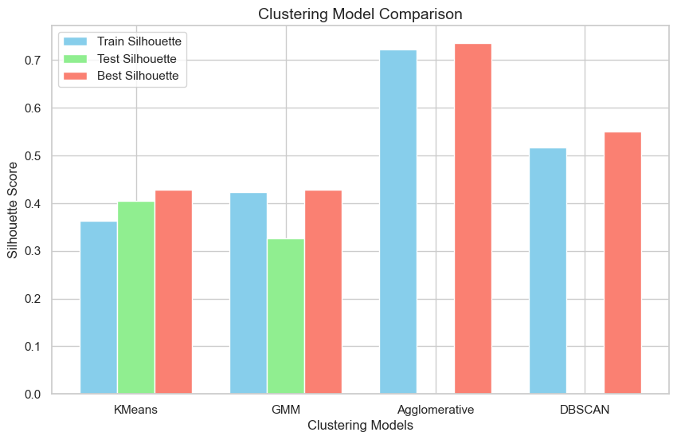
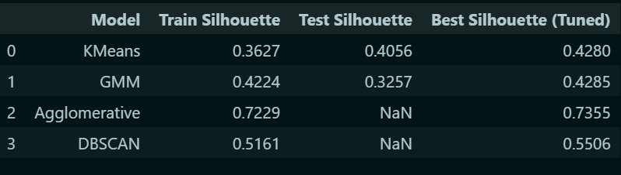
Selecting Model
Best choice: K Means
Why:
Good generalization (train ≈ test Silhouette).
Can to deploy for new customers: Make predictions
Number of clusters: 9 (after tuning): manageable for marketing segmentation
No Overfitting or Underfitting.
Stability: Consistent Performance After Tuning

Slide 22
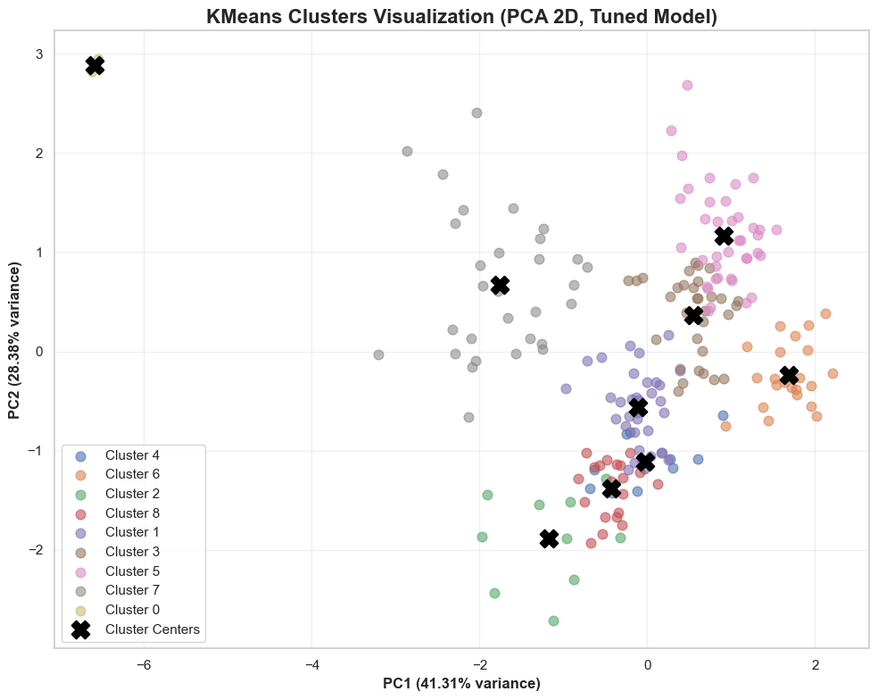
Cluster | Avg Age | Avg Income | Avg Spending | Segment Type | Marketing Strategy
0 | 35.5 | 78.0 | 1.0 | SPENDERS | Payment plans, credit offers
1 | 47.4 | 56.9 | 47.1 | BALANCED | Standard & personalized offers
2 | 55.2 | 26.9 | 13.0 | BUDGET | Discounts, loyalty rewards
3 | 24.8 | 55.8 | 49.5 | BALANCED | Standard & personalized offers
4 | 34.1 | 23.5 | 25.5 | BUDGET | Discounts, value bundles
5 | 32.7 | 86.5 | 82.1 | HIGH VALUE | Premium products, VIP programs
6 | 25.3 | 25.7 | 79.4 | SAVERS | Investment opportunities
7 | 41.4 | 90.2 | 16.6 | SPENDERS | Payment plans, credit offers
8 | 64.8 | 53.1 | 49.9 | BALANCED | Standard & personalized offers
The KMeans clustering identified 9 customer segments: High Value Spenders, Balanced Customers, Budget Conscious, and Savers. Each group shows distinct income and spending patterns, helping us target marketing strategies effectively and personalize offers for better engagement.

